Slide 1

A new database for ortholog annotation between 2 organisms.
FIT was built from MGI
BIOMART also available
Adrian M Altenhoff, Natasha M Glover, Clément-Marie Train, Klara Kaleb, Alex Warwick Vesztrocy, David Dylus, Tarcisio M de Farias, Karina Zile, Charles Stevenson, Jiao Long, Henning Redestig, Gaston H Gonnet, Christophe Dessimoz, The OMA orthology database in 2018: retrieving evolutionary relationships among all domains of life through richer web and programmatic interfaces, Nucleic Acids Research, Volume 46, Issue D1, 4 January 2018, Pages D477–D485,

Slide 2
OMA- How many gene of each ortholog type are we talking about?
human | mouse
322 | 189 | One to many
285 | 517 | Many to one
375 | 405 | Many to many
982 (454 are considered one2one in FIT) | 1111 (435 are considered one2one in FIT) | Sum
question- some genes are annotated as one kind of ortholog, but based on our data they are a different kind.
For example- 1->2 gene according to OMA, but in our data there is only data on only one of the human orthologs. Thus it is a 1->1 ortholog.
Change annotation? Treat them according to our data?

Slide 3
Panther- how many orthologs of each type?
human | mouse
929 | 349 | One to many
454 | 1545 | Many to one
844 | 1250 | Many to many
2227 | 3144 | Sum
**one2one = 15,732

Slide 4
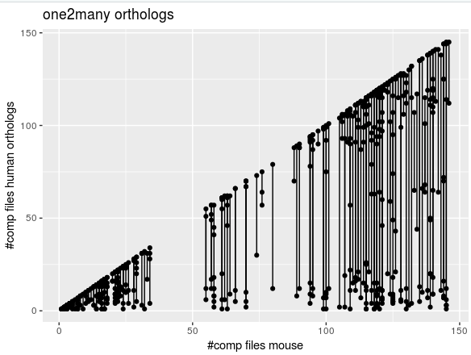
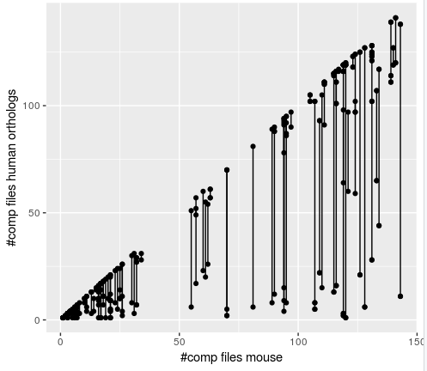
One2many genes- number of comp files
Each line= 1 gene in mouse.
# of dots on line = number of human orthologs.
Bottom left genes (under the 50:50 lines) are genes we will not be able to use, since there is not enough information.
In OMA:
50 genes have more than 50 mouse data points.
All together in plot- 99 genes.
In panther:
50 genes have more than 50 mouse data points.
All together in plot- 99 genes.
panther
OMA

Slide 5
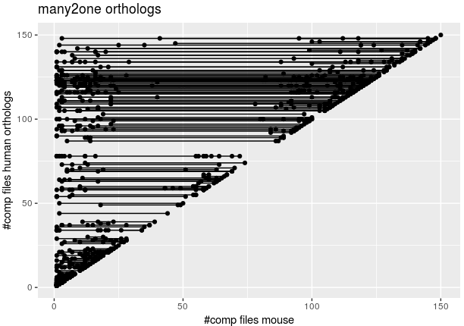
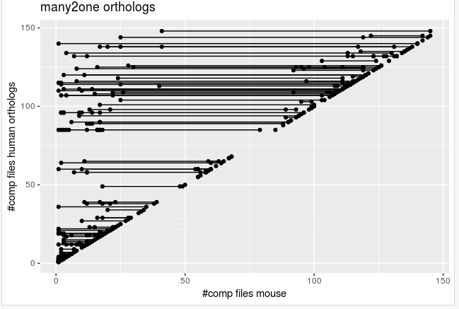
many2one genes- number of comp files
panther
OMA

Slide 6
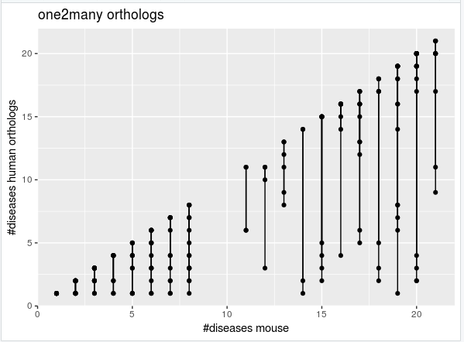
One2many genes- number of diseases
Each line= 1 gene in mouse.
# of dots on line = number of human orthologs.
Many of the lines represent many genes… so this graph is not very good. The comp graph represents the same but better.

Slide 7
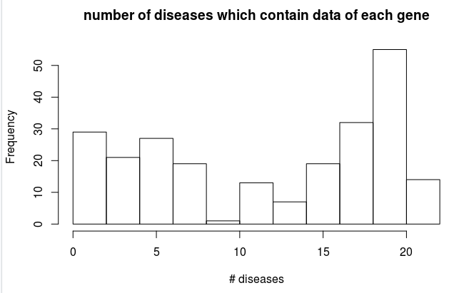
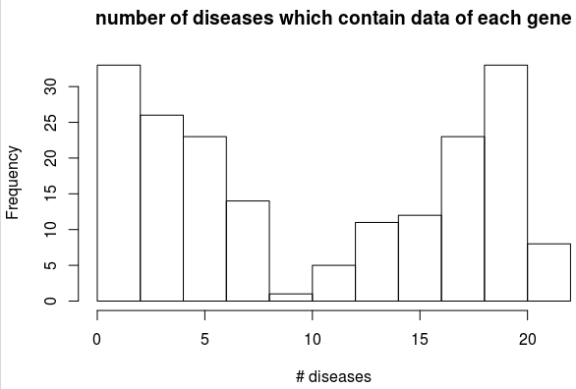
One2many genes- number of diseases
panther
OMA

Slide 8
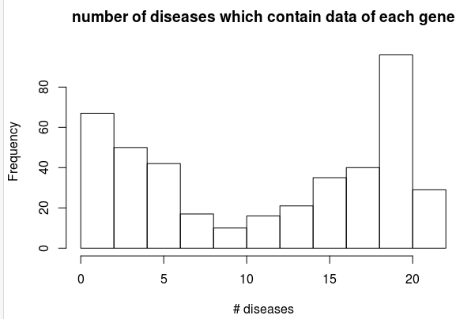
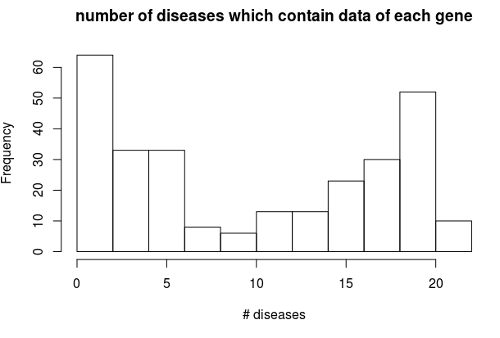
many2one genes- number of diseases
panther
OMA

Slide 9
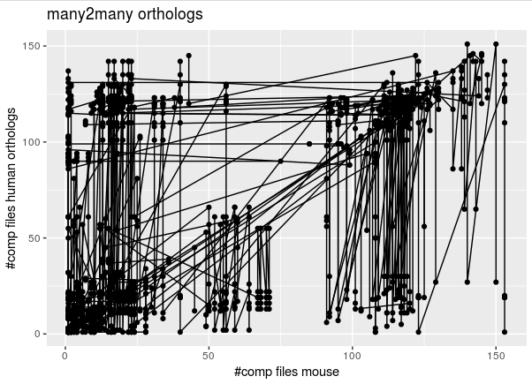
Each line is a many2many group.
I don’t think we can conclude anything from this…

Slide 10
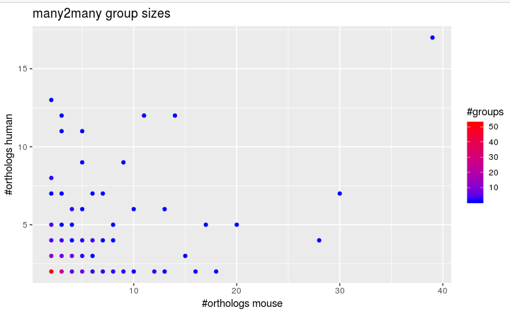
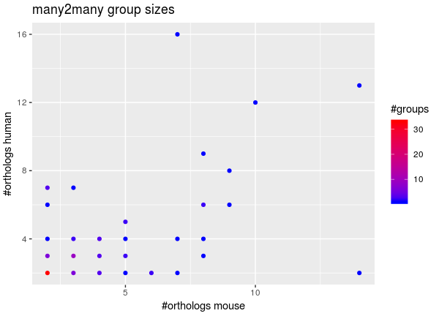
Many2many group sizes.
In each many2many group- how orthologs does it contain from each species?
Notice-minimum is 2*2, otherwise its not many2many.
OMA: 136 groups. 780 genes (375 human, 405 mouse)
panther
OMA

Slide 11
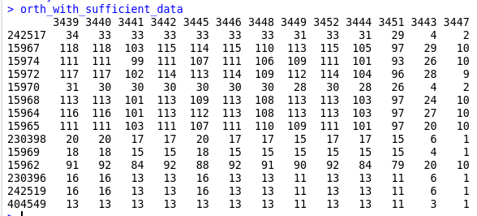
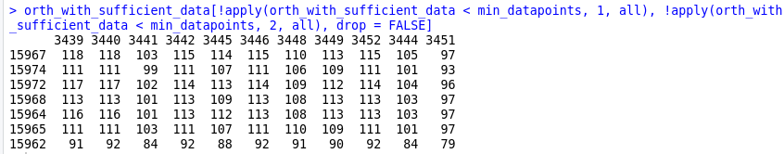
Example- how to filter out orthologs with small amount of data.
a group of many2many orthologs. 13 in human, 14 in mice.
Filter out the rows or columns in which all values are smaller than 40. these have no ortholog from the other species that has enough data to work with.

Slide 12
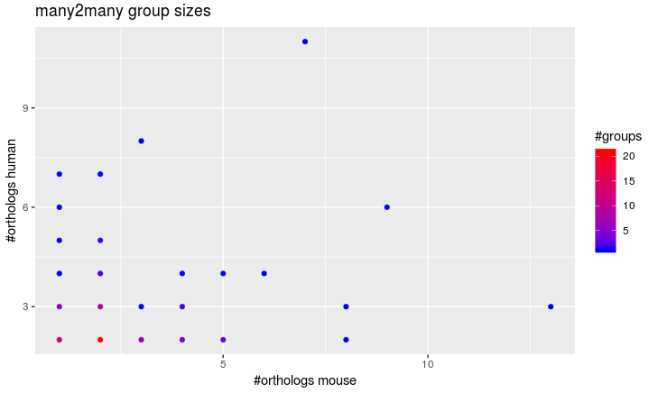
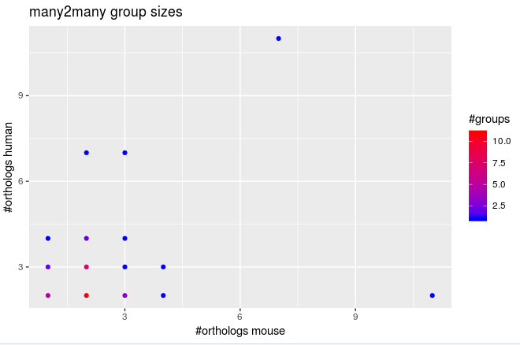
Same graph with altered groups- after the filtering.
OMA: 67 groups. 293 genes (146 human 147 mouse). (some “groups” are now one2many/ one2one)
Panther: 122 groups. 581 genes (282 human, 299 mouse)
panther
OMA

Slide 13
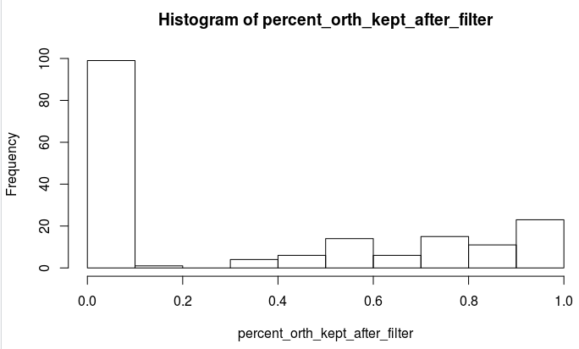
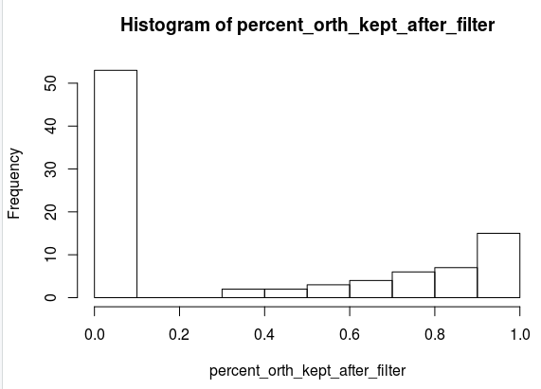
I filtered each many2many group to have only the genes that have at least one ortholog with which they have 40 data points or more, and can therefore be significant.
The percent of genes I was left with is plotted here.
~50 many2many groups were completely eliminated due to lack of data points.
~20 groups were left with all of their original orthologs.
panther
OMA

Slide 14
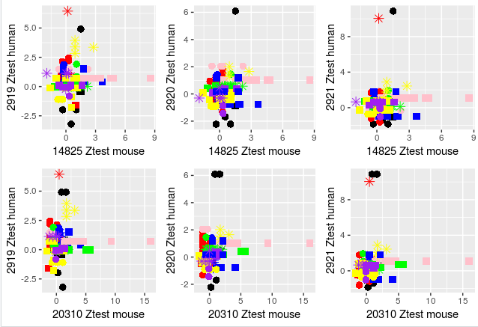
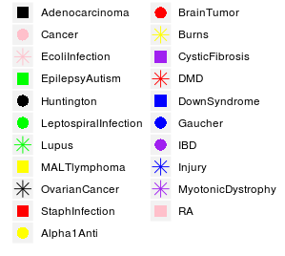
Many2many Example (Group 14).
All pairs have >50 data points.
In the many2many looking separately at pairs might not be enough.

Slide 15
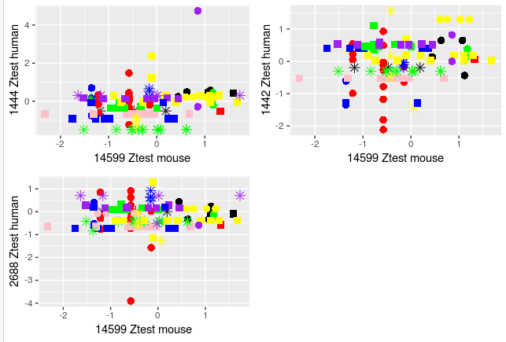
One2many example

Slide 16
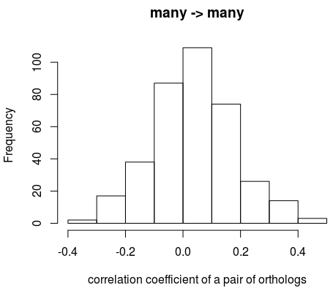
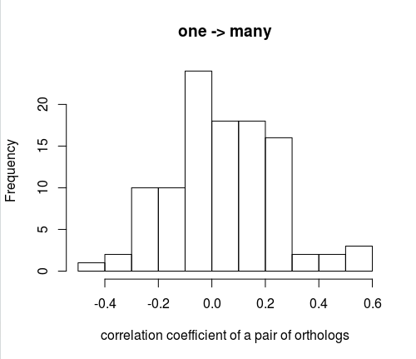
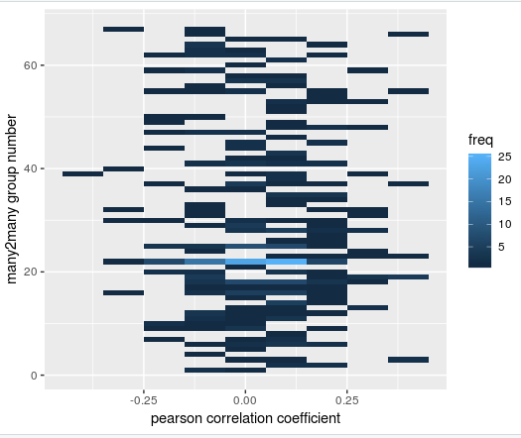
Pearson correlation between every 2 orthologs.
No correlations…. ☹
(Maybe I should do a positive control with 1->1)
OMA
Notes:
מיון לפי הבדל בין קיצוניים

Slide 17
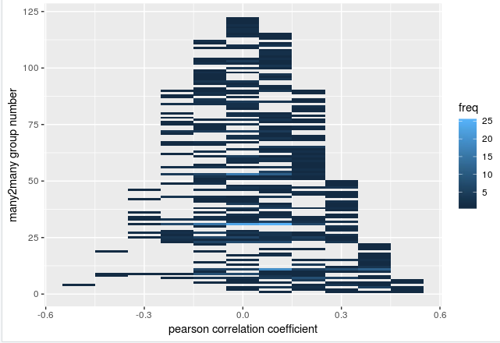
Panther: many->many
Each line is a many2many group that has more than 40 comp files of data. In total 122 groups.
Freq (# groups) | Max Pearson’s correlation in group (abs)
17 | 0
81 | 0.1
111 | 0.2
75 | 0.3
50 | 0.4
18 | 0.5

Slide 18
#human genes with 'good' mouse representatives | correlation threshold
284 | 0
256 | 0.1
168 | 0.2
81 | 0.3
30 | 0.4
10 | 0.5
1 | 0.6
For each correlation threshold, how many human genes have good mouse representatives if the threshold for a good correlation was this.
**a threshold of 0 contains all of the genes.
**if one human gene has more than 1 mouse representative that fits, we will still only count it once.

Slide 19
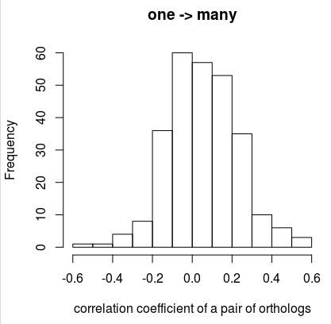
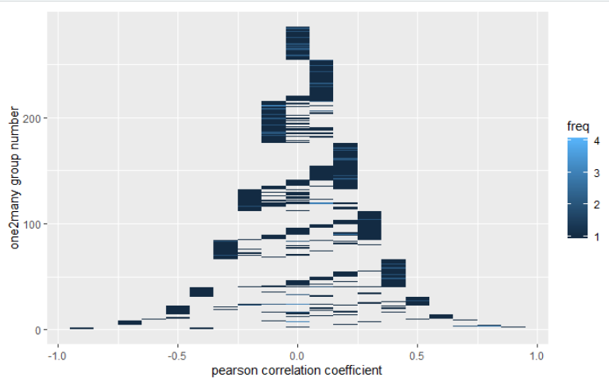
Panther: one->many
Only correlate orthologs that have more than 15 data points
Notes:
Sort by variance
Merge all 3 ortholog types
Negative correlation- not good for orthologs. Don’t use abs
Use 30 datapoints
Correlation vs percent agreement scatter plot
Substract the highest corr from one after it. Sort by this.
After regression mind slope not just squared means
Bootsampling as length of matrix

Slide 20
#human genes with 'good' mouse representatives | correlation threshold
743 | 0
409 | 0.1
243 | 0.2
138 | 0.3
82 | 0.4
37 | 0.5
18 | 0.6
13 | 0.7
6 | 0.8
2 | 0.9
Panther: one->many
For each correlation threshold, how many human genes have good mouse representatives if the threshold for a good correlation was this.
**a threshold of 0 contains all of the genes.
**if one human gene has more than 1 mouse representative that fits, we will still only count it once.
**genes that have >10 datapoints.

Slide 21
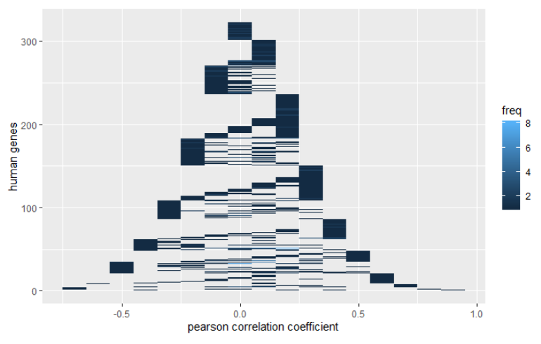
Panther: many->one

Slide 22
#human genes with 'good' mouse representatives | correlation threshold
425 | 0
301 | 0.1
235 | 0.2
150 | 0.3
85 | 0.4
47 | 0.5
20 | 0.6
7 | 0.7
2 | 0.8
1 | 0.9
Panther: many->one
For each correlation threshold, how many human genes have good mouse representatives if the threshold for a good correlation was this.
**a threshold of 0 contains all of the genes.
**if one human gene has more than 1 mouse representative that fits, we will still only count it once.
**genes that have >10 datapoints.

Slide 23
Recap:
Last we met I chose a database called OMA wich had limited number of orthologs.
I am now using PANTHER- Protein ANalysis THrough Evolutionary Relationships.
human | mouse
929 | 349 | One to many
454 | 1545 | Many to one
844 | 1250 | Many to many
2227 | 3144 | Sum
**one2one = 15,732
Mi, H., Dong, Q., Muruganujan, A., Gaudet, P., Lewis, S., & Thomas, P. D. (2009). PANTHER version 7: improved phylogenetic trees, orthologs and collaboration with the Gene Ontology Consortium. Nucleic acids research, 38(suppl_1), D204-D210.

Slide 24
3 directions for project:
Pearson correlation.
Lasso regression.
Analyzing the ortholog group together as a whole.

Slide 25
Spearman Correlation

Slide 26
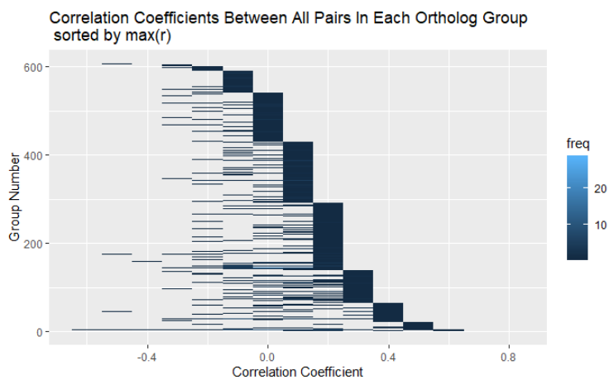
Panther: All orthologs together
Each line is a group of orthologs.
Sorted by the max correlation coefficient out of all pairs in ortholog group.

Slide 27
How many human genes
have good mouse representatives?
#human genes with 'good' mouse representatives | correlation threshold
1817 | 0
751 | 0.1
464 | 0.2
229 | 0.3
94 | 0.4
33 | 0.5
11 | 0.6
2 | 0.7
For each correlation threshold, how many human genes have good mouse representatives if the threshold for a good correlation was this.
**a threshold of 0 contains all of the genes (that have enough data points).
**if one human gene has more than 1 mouse representative that fits, we will still only count it once.
**genes that have >30 datapoints.

Slide 28
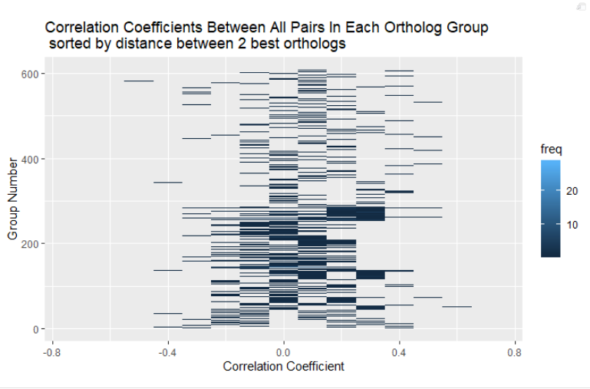
Human genes
Mouse genes
A
C
0.1
0.2
1.1
D
1.5
B
0.1
0.8
E
In this (fake) example, we have 2 best pairs! How can we choose?
Notes:
להראות בנפרד הכי טובים והכי גרועים

Slide 29
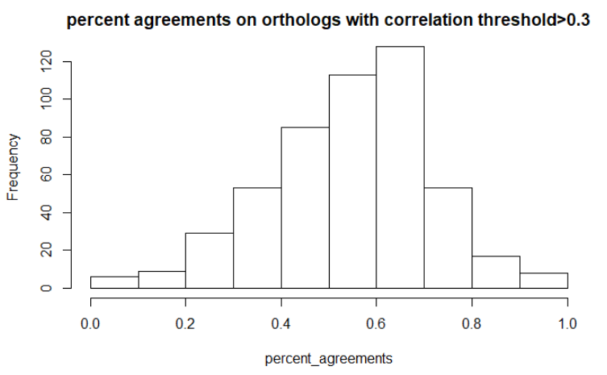
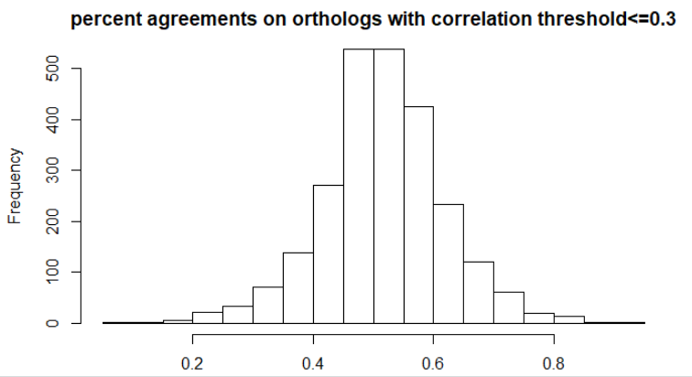
For corr_threshold=0.3, what is the percent agreement for the orthologs with correlation greater than that.

Slide 30
Linear Regressions

Slide 31
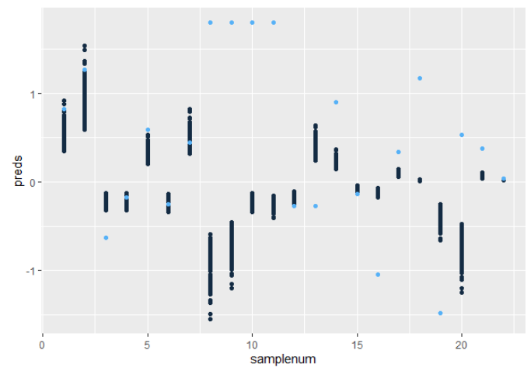
The data we have from each ortholog pair:
Test set on 1 ortholog pair (human 9 mouse 17960)
22 samples in the test set.
Each sample gets 100 predictions (1 for each slope)
And has 1 truth value
If predictions are close to each other, confidence level is higher.
Problem- because we forced the intercept to be 0, the closer the data points are to 0, the higher the confidence level is.
TODO- talk about intercept=0 and try without!
TODO- talk about how can I use the variance (the confidence level).
Notes:
לא להוציא נתוני מבחן. אלא לבחור זוג טוב הוא זוג שיש לו רגרשיין טוב.
גנים שקרובים ל0 לא נותנים לנו הרבה- הם לא משמעותיים. אולי לבחון את הגנים שכן משתנים בלבד. וזה ה"תירוץ" להשתמש בכל זאת בconfidence level.

Slide 32
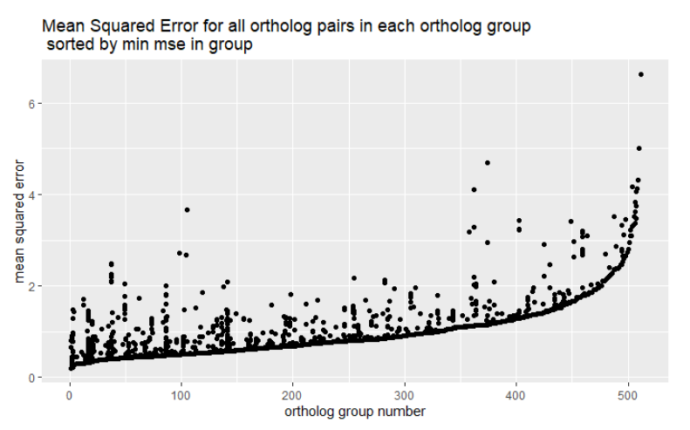
Mean squared error-
sorted by lowest in group
A small mse indicates a better ortholog pair. Thus a group that is on the left, has 1 pair of orthologs that are good representatives of the group.
In the (fake) example here we have 2 “best ortholog pairs”. From this representation we are not able to distinguish these cases.

Slide 33
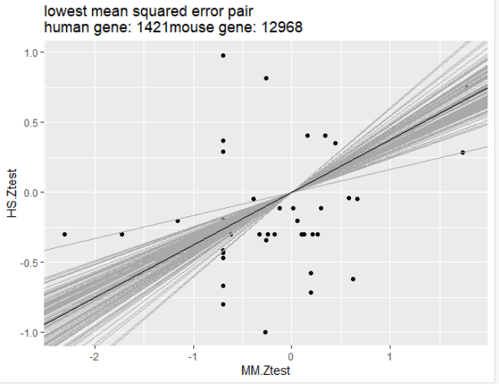
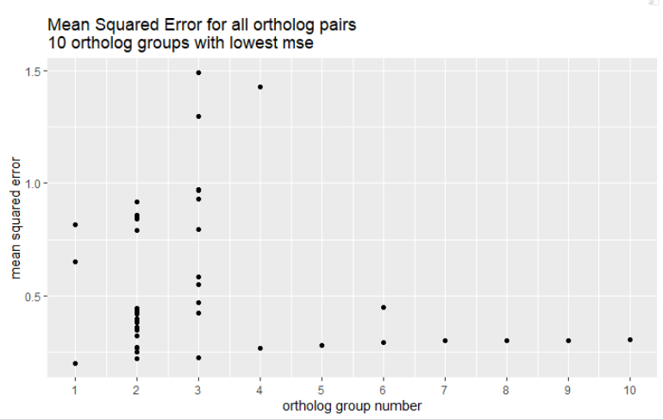
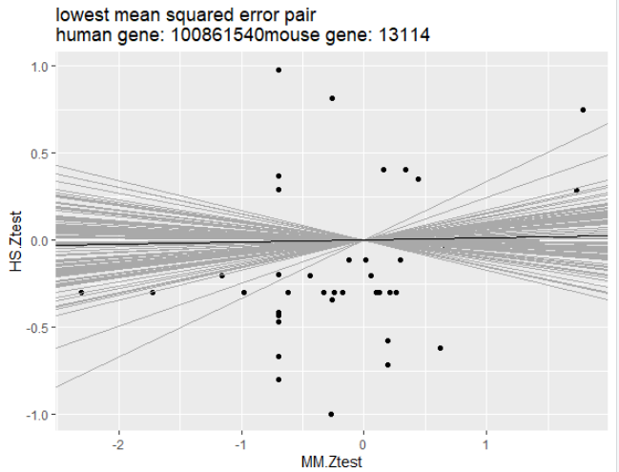
Mean squared error-
sorted by lowest in group
First 10 groups from the last graph
Remember that MSE does not say anything about the slope value!
Group1:
Group2:

Slide 34
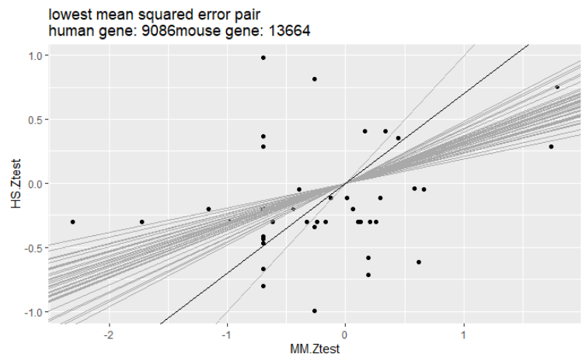
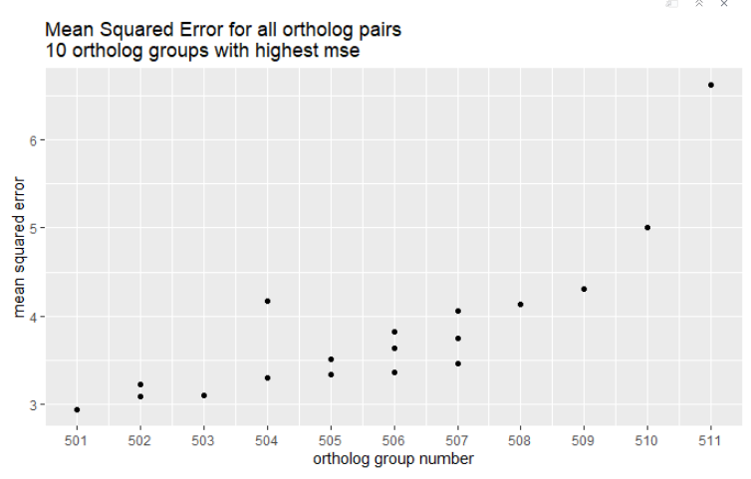
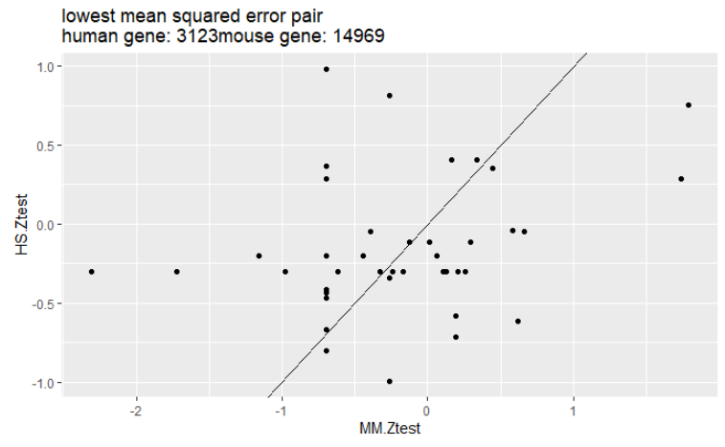
Mean squared error-
sorted by lowest in group
Group511:
Last 10 groups (groups with the highest min mse)
The shrinkage of the slope to 1 here makes the mean squared error very high.
This might not be a natural result BUT remember that when the slope is 1, it means that the regression could not converge on a meaningful solution.
Group510:

Slide 35
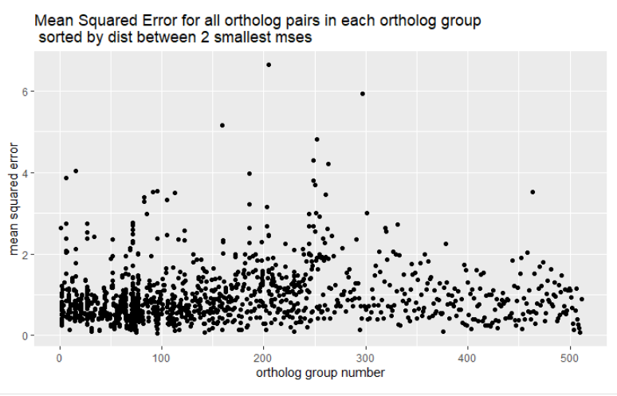
Mean squared error-
sorted by distance between the 2 lowest mse’s in group
Sorting by distance between the best 2 ortholog pairs anables us to see which groups have an absolute winner!
Notes:
להציג את ה10 כי טובים והכי רעים.
Grid כדי להפריד בין הטורים

Slide 36
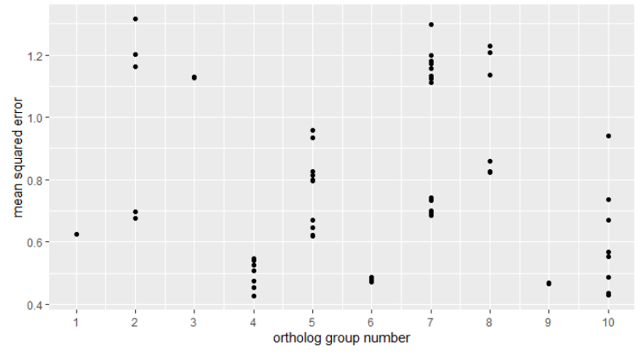
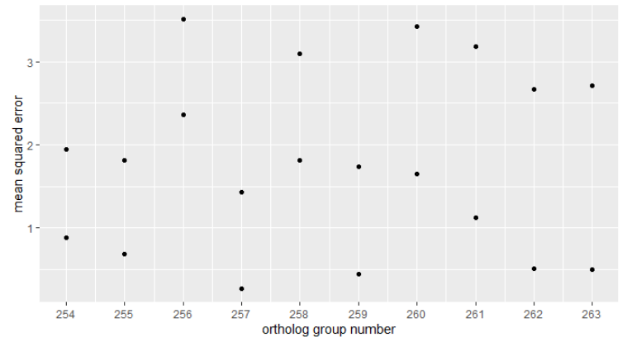
Mean squared error-
sorted by distance between the 2 lowest mse’s in group
10 groups with the smallest distance between 2 best ortholog groups
10 groups with the highest distance between 2 best ortholog groups

Slide 37
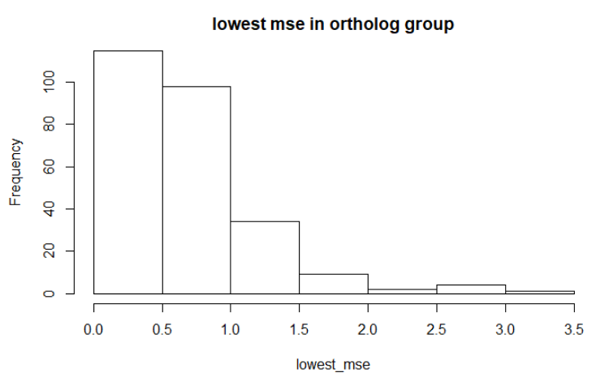
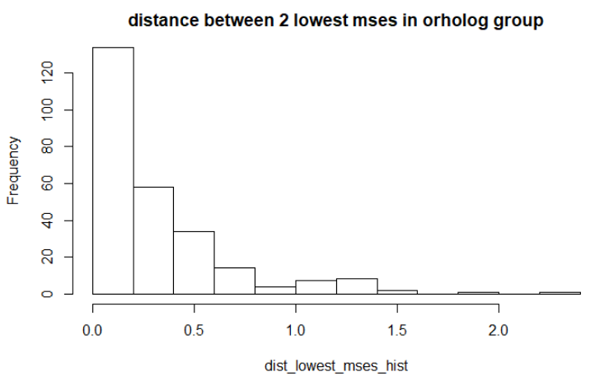
Conclusion- given the 2 values,
For which groups are we successful in finding a
Good ortholog pair to represent them?
Notes:
לחזור לגרף המקורי של אדם מול עכבר (ztest). של קבוצת אורתולוגים עם ערכים של MSE טובים ורעים במיוחד.

Slide 38
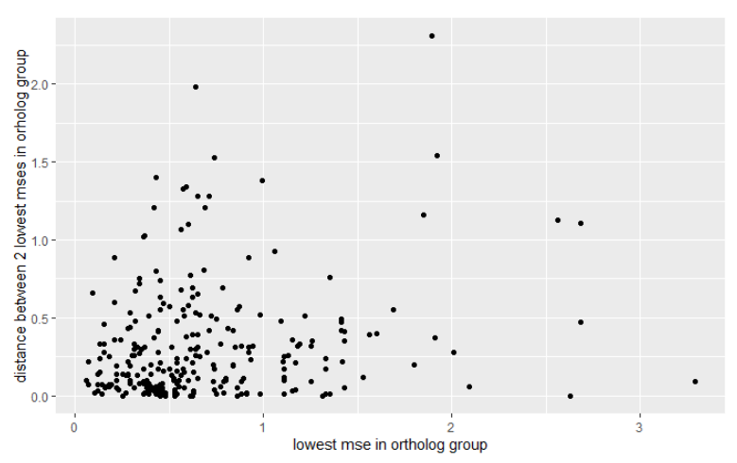
Conclusion- given the 2 values,
For which groups are we successful in finding a
Good ortholog pair to represent them?
Maybe use both?
Each dot is a group of orthologs. X axis is the lowest value of mean squared error out of all of its ortholog pairs. Y axis is the distance between its 2 “best” ortholog pairs.
We would like to see how many group have a low mse ortholog pair that is also far away from the next best ortholog pair.
Ideally we would like to have the dots in the top left corner..

Slide 39
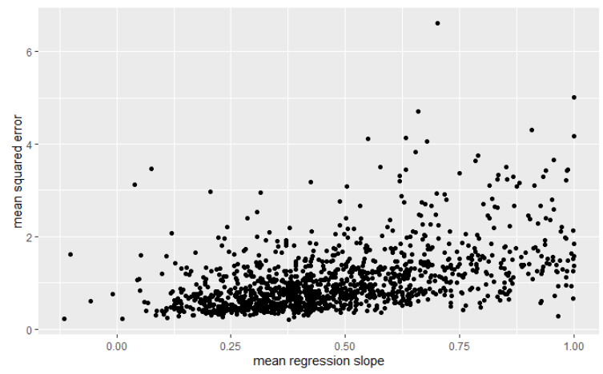
Considering the regression slope?
Each dot is a pair of orthologs.
Ideally we would want high mean regression slope (mean is taken on the 100 bootstrapping results), low mse.
Is a high slope absolutely what we would want? Maybe a strong upregulation in human is translated into a low upregulation in mouse! But slope of 0, does not make sence (the human gene is NEVER upregulated?)
Remember- slopes at 1 or close to one usually simply means the regression did not converge.
No slopes above 1? (all slopes from model are negative…)

Slide 40
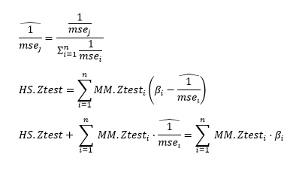
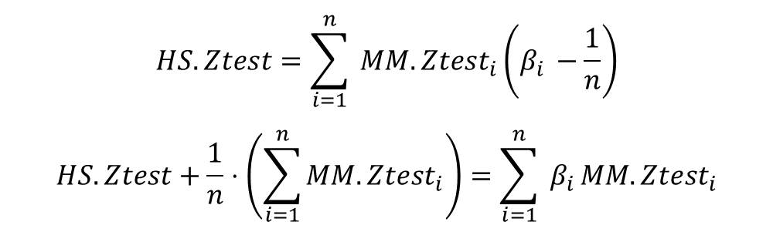
Looking at an ortholog group as a whole
(without choosing the best pair)
All orthologs are equal:
$$HS.Ztest=\sum_{i=1}^{n}{ MM.Ztest_{i}\left(β_{i }−\frac{1}{n}\right)}$$
$$HS.Ztest+\frac{1}{n}⋅\left(\sum_{i=1}^{n}{MM.Ztest_{i}}\right)=\sum_{i=1}^{n}{ β_{i }MM.Ztest_{i}}$$
Weighted importance be mean squared error/ slope value…

Slide 41
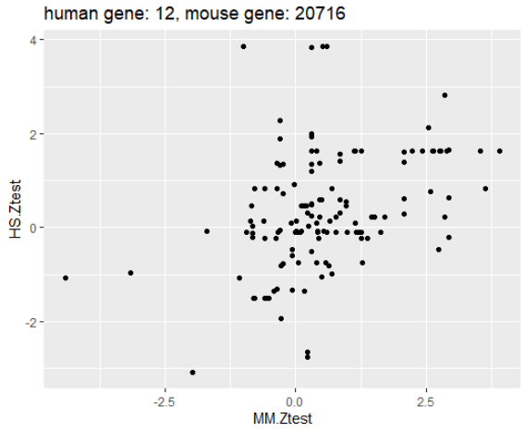




Beta | Mouse Gene
1.0569815 | 20716
0.7275608 | 20717
0.7207262 | 16625
0.6508234 | 20715
0.4653339 | 20714

Slide 42
Mean squared error on each test disease
Test disease | MSE- couples | MSE- groups
Adenocarcinoma | 1.312539 | 0.771121
Cancer | 1.410847 | 1.668447
EcoliInfection | 1.475708 | 1.207669
EpilepsyAutism | 1.381651 | 1.334337
Huntington | 1.206058 | 1.193235
LeptospiralInfection | 1.908814 | 3.668076
Lupus | 1.624094 | 1.938926
MALTlymphoma | 1.659661 | 2.49067
OvarianCancer | 1.128379 | 1.042061
StaphInfection | 1.524902 | 1.566677
Alpha1Anti | 1.079539 | 1.027096
BrainTumor | 1.734872 | 0.846319
Burns | 1.618415 | 1.263457
CysticFibrosis | 2.022901 | 1.44294
DMD | 2.367542 | 2.116078
DownSyndrome | 1.150919 | 1.317754
Gaucher | 1.274626 | 1.092692
IBD | 1.767011 | 2.921771
Injury | 1.451702 | 1.197053
MyotonicDystrophy | 0.982072 | 1.153007
RA | 1.604642 | 1.393242
ASPS | 2.160518 | 2.163471
ProstateCancer | 0.604486 | 1.078302
AtopicDermatitis | 0.196325 | 0.460942
In some cases- small mse simply indicates that more of the HS.Ztest values are closer to 0.

